Slide 1
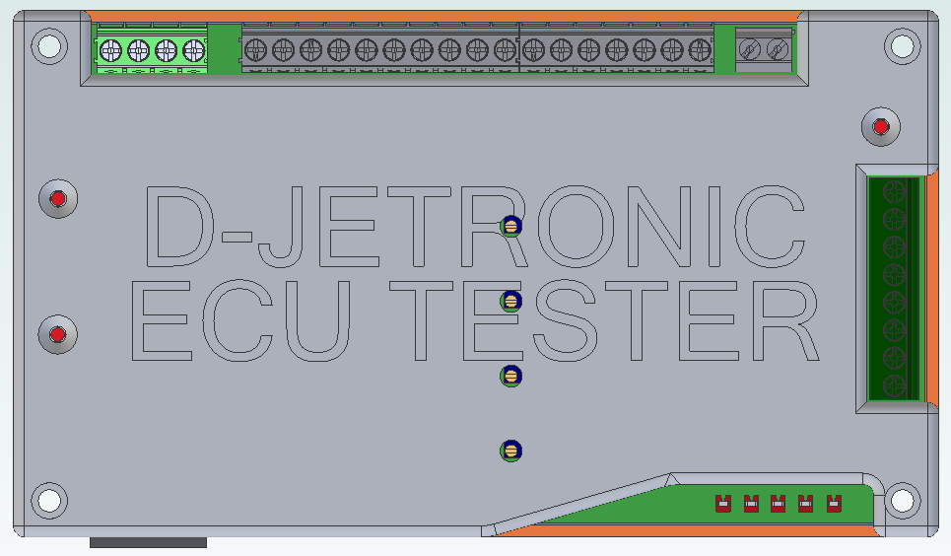
MPS
ECU inputs and outputs
12V in
ECU power light
Tester power light
USB to PC
ECU power supply
and injector
outputs
Tester status light
Injector response tuning
(I at top, IV at bottom)
ECU power switch
Injector pulse test points
(left to right: GND, IV, III, II, I)

Slide 2
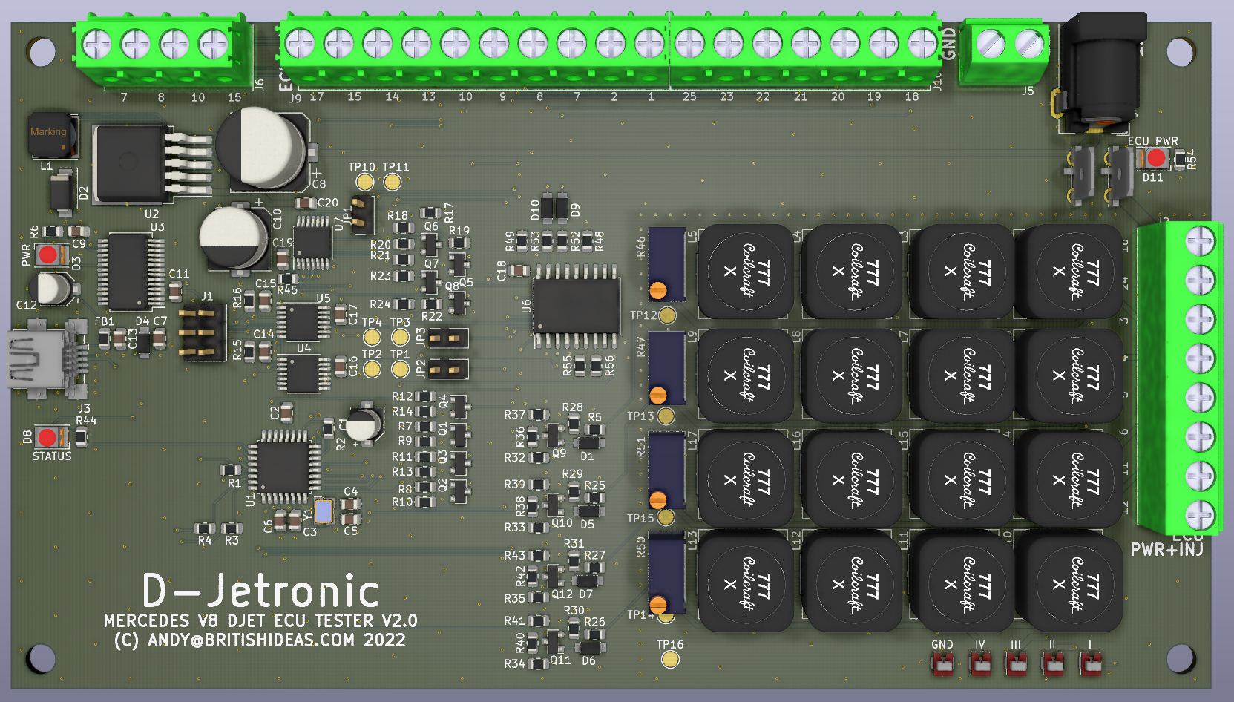
Group I tuning resistance
measurement point
II
III
IV
GND points

